Slide 1
SHADing LANGUAGES
3DCC day3

Slide 2
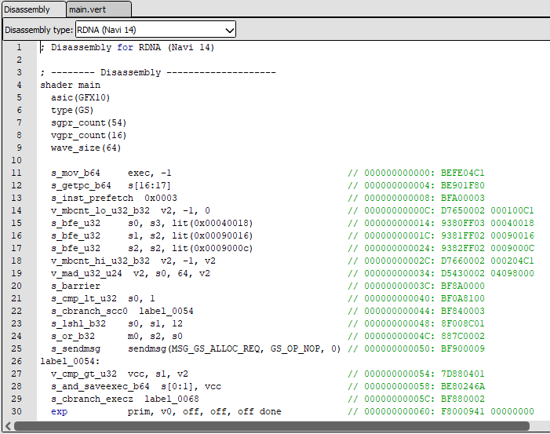
programmable GPU STAGES
Before around 2001graphics cards & APIs were mostly fixed-function pipelines.
This meant API programmers had very little control over how something was transformed or shaded. (no variety)
With the advent of shaders, developers gained significantly more control over vertex and pixel processing. (visual styles)
Today, shaders are mostly written in higher level languages that get compiled into GPU assembly that cards can use.

Slide 3
HARDWARE SHADING LANGUAGES
High level shading language (HLSL)
OpenGL shading language (GLSL)
Other shading languages
Developed by Microsoft for use by their DirectX rendering APIs, HLSL is a very popular and widely used C style language.
GPU APIs supporting HLSL:
Direct3D9, 10, 11 and 12
Vulkan
Developed by 3D Labs, GLSL was years ago adopted into the core of OpenGL 2.0. It is the official shader language of OpenGL, and the original shading language of Vulkan.
GPU APIs supporting GLSL:
OpenGL
Vulkan
CG (C for Graphics)
An intermediary shading language designed by NVidia. (discontinued)
PlayStation Shader Language (PSSL)
Used by PS4/PS5, essentially HLSL with a few console specific additions.
C++ (MacOS & iOS)
Apple’s Metal API uses C++ directly.

Slide 4
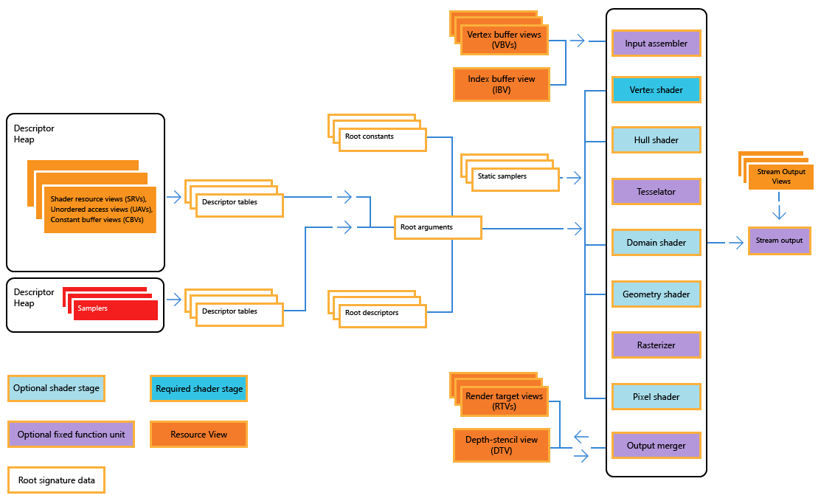
HLSL SHADER TYPES
Direct3D12 Pipeline
Mesh Shader*
Vertex Shader
Hull Shader
Domain Shader
Geometry Shader
Pixel Shader
Compute Shader
Any Hit, Callable, Closest Hit, Intersection, Miss, Ray Generation*
*Only Available in DirectX12 Ultimate

Slide 5
HLSL SYNTAX: SCALAR, VECTOR & MATRIX TYPES
Scalar Types: (single component)
bool, int, uint, dword, half, float, double
Vector Types: (1 to 4 components)
uint2, int3, float4, etc…
Matrix Types: (2 to 16 components)
uint2x3, float4x4, double2x2, etc…
Many similarities to basic C/C++
The use of Structures is extremely common.
Templates are also present but only required for specific types.

Slide 6
HLSL SYNTAX: GPU RESOURCE TYPES
Uniform Definition & Access
cbuffer (a specialized version of the struct keyword)
Texture Access
Texture2D, TextureCUBE, Texture1D, Texture3D
Texture Quality
SamplerState
Custom Resource Access
Buffer<>, RWBuffer<>, StructuredBuffer<>, RWStructuredBuffer<>, etc…

Slide 7
HLSL SYNTAX: SEMANTICS & SYSTEM SEMANTICS
Semantics
Found at the end of variable declarations being passed into and out of shaders.
These identify what GPU register a variable is to be read from or written to.
In the Direct3D11/12 APIs you must also provide these names to the Input Assembler.
System Semantics
System reserved Semantics that each have a unique & special purpose.
Used to access/provide specific data available to or required by the pipeline.
Examples: SV_Position, SV_Target, SV_Depth, SV_VertexID, SV_InstanceID

Slide 8
Sample HLSL Vertex Shader
#pragma pack_matrix(row_major)
struct VERTEX_IN
{
float3 local_position : POSITION;
};
struct VERTEX_OUT
{
float4 projected_position : SV_POSITION;
};
cbuffer UNIFORMS : register( b0, space0 )
{
float4x4 worldViewProjectionCombined;
}
VERTEX_OUT main( VERTEX_IN buffer_vertex )
{
VERTEX_OUT to_rasterizer = (VERTEX_OUT)0;
float4 homogenous_positon = float4(buffer_vertex.local_position, 1);
homogenous_positon = mul( homogenous_positon, worldViewProjectionCombined);
to_rasterizer.projected_position = homogenous_positon;
return to_rasterizer;
}

Slide 9
Sample HLSL PIXEL Shader
Texture2D DiffuseTexture : register( t0, space1 );
SamplerState QualityFilter : register( s0, space1 );
cbuffer UNIFORMS : register( b0, space0 );
{
float4 LightDirection;
float4 LightAmbient;
float4 LightColor;
}
float4 main(float3 Interpolated_Normal : NORMAL, float2 Interpolated_UV : TEXTURECOORDINATE) : SV_TARGET
{
float4 diffuseColor = DiffuseTexture.Sample( QualityFilter, Interpolated_UV );
float3 surfaceNormal = normalize( Interpolated_Normal );
float lightRatio = saturate( dot( surfaceNormal, -LightDirection.xyz) );
return saturate(LightColor * lightRatio + LightAmbient) * diffuseColor;
}

Slide 10
HLSL VULKAN SPECIFIC FEATURES
struct DATA { matrix instance; float4 color; };
[[vk::push_constant]]
cbuffer PUSH_CONSTANTS {
matrix world;
};
[[vk::binding(0, 0)]]
cbuffer UNIFORM_BUFFER {
matrix view, projection;
float4 lightDirection, lightPosition, lightColor;
};
[[vk::binding(0, 1)]]
StructuredBuffer<DATA> StorageBuffer;
[[vk::binding(0, 2)]]
Texture2D descriptorTexture;
[[vk::binding(0, 2)]]
SamplerState matchingFilter;
These optional language markers allow developers using HLSL with Vulkan to explicitly connect shader code to Vulkan API resources.
Some of the most common ones are shown above, click here for all the details.
The : register( X, spaceY ) syntax can also used for binding to VkDescriptorSets.

Slide 11
GLSL CRASH COURSE - VERTEX & FRAGMENT
#version 330
uniform mat4 viewProjection;
uniform mat4 world;
layout (location = 0) in vec3 local_pos;
layout (location = 1) in vec2 local_uv;
out vec2 uvToFragment;
void main()
{
uvToFragment = local_uv;
gl_Position = viewProjection * world * vec4(local_pos, 1);
}
#version 330
uniform sampler2D diffuseTexture;
in vec2 interpolated_uv;
void main()
{
fragColor = texture(diffuseTexture, interpolated_uv);
}
https://www.khronos.org/opengl/wiki/OpenGL_Shading_Language

Slide 12
Compiling shaders
This is largely dependent on your chosen API, but in general there are two ways:
Pre-Compiling (Reduces load times)
Shaders are compiled into byte-code files ahead of time.
These files are then read and transferred to video memory so the GPU can use them.
Runtime-Compiling (JIT Just-In-Time compiling)
A shader’s raw source is compiled at run-time by the CPU, then transferred to the GPU memory for use. Many commercial game engines use this feature to allow custom shaders.
Visual Studio can compile any valid HLSL file in your project into a *.cso file.
CSO stands for Compiled Shader Object, its is a raw bytecode file. Only Direct3D APIs can read this.
Google’s shaderc library, can compile both HLSL & GLSL into SPIR-V bytecode.
SPIR-V is shader bytecode that Vulkan understands how to use.
OpenGL sends GLSL source code directly to the driver, which is responsible for compiling it.

Slide 13
USING SHADERS: VULKAN
Objects
VkShaderModule, shaderc_compiler_t, shaderc_compile_options_t
Compiling Functions
shaderc_compile_into_spv(…), shaderc_result_get_bytes(…)
Creation Functions
GvkHelper::create_shader_module(…)
Pipeline Descriptors
VkPipelineShaderStageCreateInfo
Clean-up Functions
vkDestroyShaderModule(…)

Slide 14
USING SHADERS: DIRECT3D12
Objects
ID3DBlob*
Compiling Functions
D3DCompile(…)
Pipeline State Descriptors
CD3DX12_SHADER_BYTECODE
Clean-up Functions
Release(…)

Slide 15
USING SHADERS: DIRECT3D11
Objects
ID3D11VertexShader*, ID3D11PixelShader*, ID3D11GeometryShader*, ID3D11HullShader*, ID3D11DomainShader*, ID3D11ComputeShader*
Compiling Functions
D3DCompile(…)
Creation Functions
CreateVertexShader(…), CreatePixelShader(…), CreateGeometryShader(…), CreateHullShader(…), CreateDomainShader(…), CreateComputeShader(…)
Setting Functions
VSSetShader(…), PSSetShader(…), GSSetShader(…), HSSetShader(…), DSSetShader(…), CSSetShader(…)
Clean-up Functions
Release(…)

Slide 16
USING SHADERS: OPENGL
Shader/Program Handles
GLuint
Creation Functions
glCreateShader(…), glShaderSource(…), glCreateProgram(…)
Compiling Functions
glCompileShader(…), glGetShaderiv(…), glGetShaderInfoLog(…)
Linking Functions
glAttachShader(…), glLinkProgram(…), glGetProgramiv(…)
Binding Functions
glUseProgram(…)
Clean-up Functions
glDeleteShader(…), glDeleteProgram(…)

Slide 17
DEBUGGING SHADERS (API DEBUGGING)
Unlike CPU debugging, the built in IDE debugger is generally not capable of inspecting a graphics API since much of what you do happens on the GPU.
A more specialized tool built specifically for this purpose will be necessary.
Many such tools have come and gone over time, but generally there are three common options depending on the API in use:
The Visual Studio Graphics Debugger (Direct3D11 only)
Microsoft PIX (Direct3D12 only)
RenderDoc (Direct3D11/12, Vulkan, OpenGL)

Slide 18
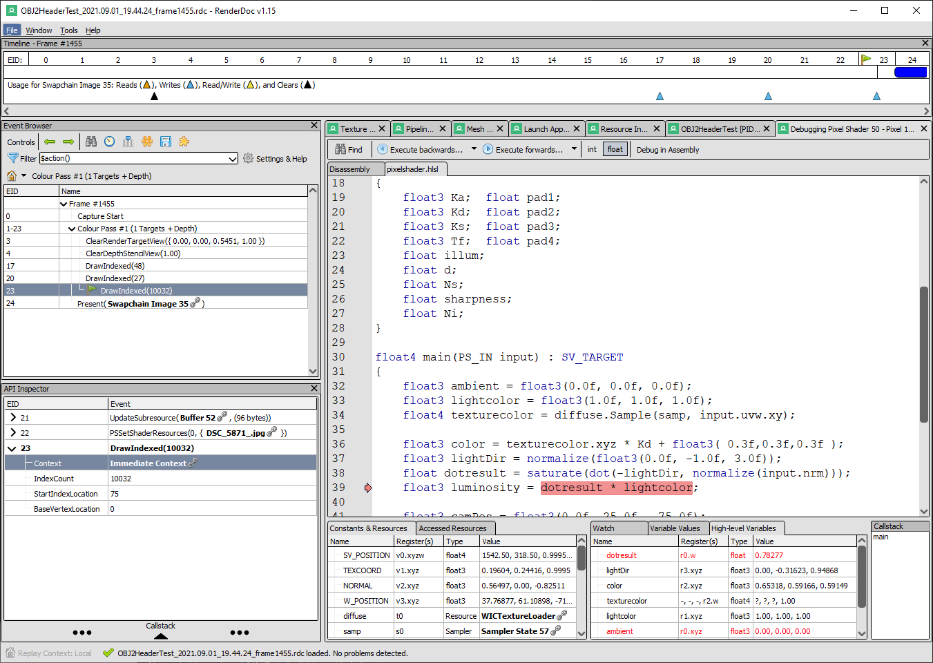
Renderdoc
An incredibly powerful and versatile development tool, RenderDoc enables pipeline and shader debugging on nearly every graphics API available!
Use it to launch the Debug executable of your program. It will capture the various calls to the GPU so you can inspect what is really going on.
There is a short learning curve, but once you get to grips with it you will wonder how you ever wrote anything without it!

Slide 19
Shader uniforms
In addition to vertex & texture data, shaders need to know many things:
World Matrices, Inverse Bind Matrix. (from the model/physics system)
Light Positions, Light Types, Light Colors. (from the level/environment)
Surface Material Properties. (from the model/artists)
View/Camera Matrix, Projection Matrix, Frame Time, Total Time. (from the game loop/engine)
Since this data does not change from vertex to vertex, it is considered uniform and constant during the execution of the shader code on the GPU.
However, it is expected that these variables are updated every frame or even sometimes between draw calls. For Example: you reuse a shader’s world matrix to draw two meshes.
Each API has a few different ways to upload uniforms depending on your needs.

Slide 20
Three Flavors of uniform Storage
Blazing fast but miniscule size
Really Fast and reasonable size
Fast Enough AND MASSIVE Size
Vulkan
Push Constants
Direct3D12
Root Descriptor Constants
Vulkan
Uniform Buffers
Direct3D12
Constant Buffers
Direct3D11
Constant Buffers
OpenGL
Uniform Buffer Objects
Vulkan
Storage Buffers
Direct3D12
Structured Buffers
Direct3D11
Structured Buffers
OpenGL
Shader Storage Buffer Objects

Slide 21
USING VULKAN Push constants
Pipeline Descriptors
VkPushConstantRange, VkPipelineLayoutCreateInfo
Update Functions
vkCmdPushConstants(…)
HLSL Syntax
Place the tag [[vk::push_constant]] above the first cbuffer in the shader file to link them.

Slide 22
USING D3D12 ROOT Descriptor constants
Root Signature Parameter
CD3DX12_ROOT_PARAMETER
Initialization
CD3DX12_ROOT_PARAMETER::InitAsConstants(…), CD3DX12_ROOT_SIGNATURE_DESC::Init(…)
Update Functions
SetGraphicsRootSignature(…), SetGraphicsRoot32BitConstants(…)
HLSL Syntax
Create a cbuffer with the same register specified by InitAsConstants(…) above.

Slide 23
USING DIRECT3D11 constant BUFFERS
Objects
ID3D11Buffer*
Creation/Update Functions
CreateBuffer(…), Map(…), Unmap(…)
Setting Functions
VSSetConstantBuffers(…), PSSetConstantBuffers(…), GSSetConstantBuffers(…), HSSetConstantBuffers(…), DSSetConstantBuffers(…), CSSetConstantBuffers(…)
Clean-up Functions
Release(…)
HLSL Syntax
This is what the cbuffer type is used for.

Slide 24
USING OPENGL UNIFORM BUFFER OBJECTS
Handles
GLuint
Creation/Update Functions
glGenBuffers(…), glBindBuffer(…), glBufferData(…), glMapBuffer(…), glUnmapBuffer(…)
Binding Functions
glGetUniformBlockIndex(…), glBindBufferBase(…), glUniformBlockBinding(…)
Clean-up Functions
glDeleteBuffers(…)
GLSL Syntax
This is what the uniform type is used for.

Slide 25
USING DIRECT3D12 constant BUFFERS
Objects
ID3D12Resource*, ID3D12DescriptorHeap*, CD3DX12_ROOT_PARAMETER
Creation/Update Functions
CreateCommittedResource(…), Map(…), Unmap(…), CreateDescriptorHeap(…), CreateConstantBufferView(…)
Root Signature Setup
CD3DX12_ROOT_PARAMETER::InitAsConstantBufferView(…), CD3DX12_ROOT_SIGNATURE_DESC::Init(…)
Setting Functions
SetGraphicsRootSignature(…), SetDescriptorHeaps(…), SetGraphicsRootConstantBufferView(…)
Clean-up Functions
Release(…)
HLSL Syntax
This is what the cbuffer type is used for. In Shader Model 5.1+ you can use ConstantBuffer<>

Slide 26
USING VULKAN UNIFORM & STORAGE BUFFERS
Objects
VkBuffer, VkDeviceMemory, VkDescriptorSetLayout, VkDescriptorPool, VkDescriptorSet
Creation Functions
GvkHelper::create_buffer(…), vkCreateDescriptorSetLayout(…), vkCreateDescriptorPool(…), vkAllocateDescriptorSets(…)
Update Functions
GvkHelper::write_to_buffer(…), vkUpdateDescriptorSets(…)
Binding Functions
vkCmdBindDescriptorSets(…)
Clean-up Functions
vkDestroyBuffer(…), vkFreeMemory(…), vkDestroyDescriptorPool(…), vkDestroyDescriptorSetLayout(…)
HLSL Syntax
The cbuffer type represents Uniform Buffers while StructuredBuffer<> is for Storage Buffers.

Slide 27
Programming presentation
Debugging with renderdoc part 2

Slide 28
Q

Slide 29
USING DIRECT3D11 structured BUFFERS
Placeholder

Slide 30
USING OPENGL Shader storage BUFFER object
Placeholder

